Slide 1



WavePurifier: Purifying Audio Adversarial Examples via Hierarchical Diffusion Models
Hanqing Guo^{1,2}, Guangjing Wang, Bocheng Chen, Yuanda Wang, Xiao Zhang, Xun Chen³, Qiben Yan¹,
Li Xiao¹

Slide 2
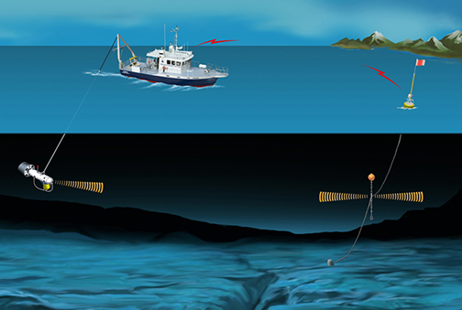
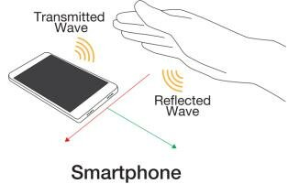





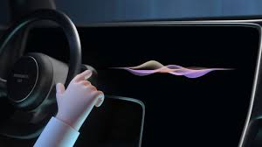
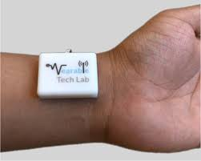

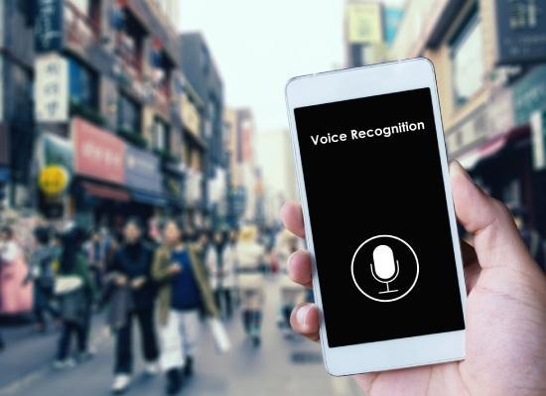

Acoustic + AI Applications
Acoustic
AI
Underwater acoustic
communication
Gesture sensing
Voice control in-car
Communication
Biometric
Sensing
Acoustic monitoring
voice control in home
Voice ID
Voice authentication for customer service
Notes:
Speech recognition technology is widely used in real world scenario. There are multiple speech to text APIs can offer speech to text transfer service: such as google cloud speech API, IBM Watson speech to text, amazon transcribe, and Microsoft Azure. Besides, there are applications that offer smart services such as google home, google assistant, Microsoft cortana, and amazon echo. With those assistants, our voice can command the smart devices to do different operations based on their accessibility, such as “read message, call 911, send message, and even open the door”

Slide 3






Acoustic AI systems are vulnerable
“Music”
Adversary
Adversarial Example
Speech Recognition
“open the door”
“0x40”
Adversary
Signal Detection [1]
Perturbations
“0x45”
“Bob”
Adversary
Attack
Speaker Authentication
“Evil”
[1] SenSys 2021 NELoRa: Towards ultra-low SNR LoRa communication with neural-enhanced demodulation.

Slide 4


Existing Countermeasures
Input-Level Defense
Model-Level Defense
Process the input to
make perturbation invalid
Make the model robust and hard to attack
Feature Squeezing
Adversarial Training
Input Preprocessing
Gradient Masking
Randomization
Defensive Distillation
Adversarial Detection
Ensemble Defense
Vulnerable to adaptive attacker
Computation intensive
Open attack interface

Slide 5
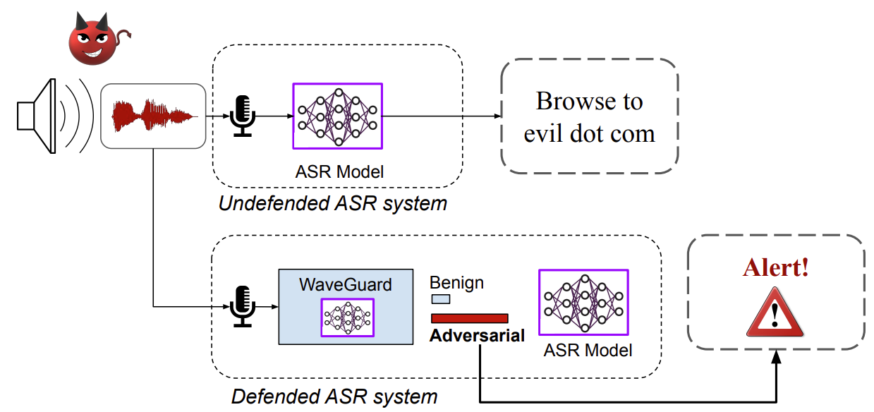
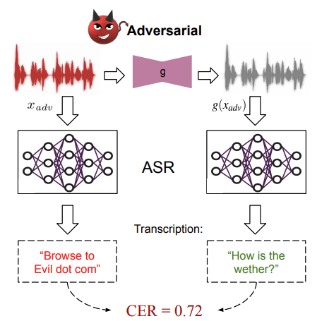


Prior Work – WaveGurad [2]
Vulnerable to adaptive attacker
“Call 911”
Attack detected
Deny of Service
“Open door”
Block benign input
[2] Usenix Security 2021 WaveGuard: Understanding and Mitigating Audio Adversarial Examples

Slide 6
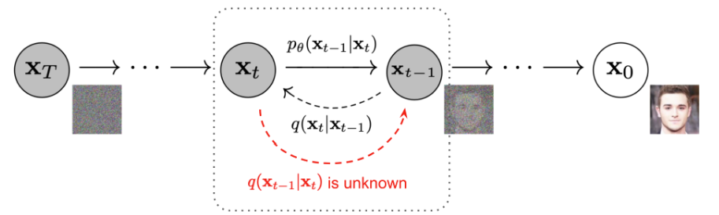
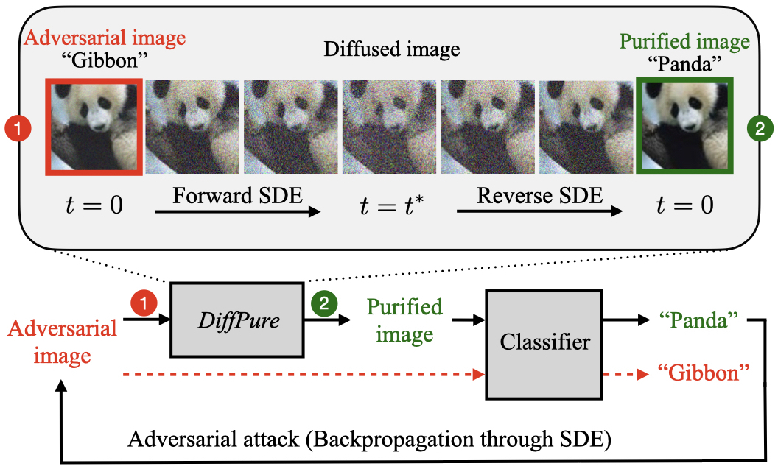

Inspiration
NeurIPS 2020 DDPM
Is it possible to purify the audio sample with diffusion model?
ICML 2022 Diffpure

Slide 7
Challenge
How to determine the Diffusion Framework?
How to prove the existence of optimal purify step?
How to determine the optimal purification step?

Slide 8
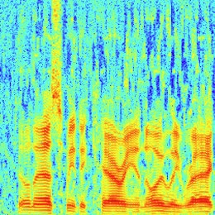
Idea – Why diffusion model?
Forward Diffusion
Adversarial Example
Add Noise to Disrupt Perturbation
Benign sample
Forward destroy perturbation
Backward Diffusion
Benign Sample
Noisy Adversarial Example
Clean data.
Backward recover benign; Because the original diffusion model is trained on

Slide 9
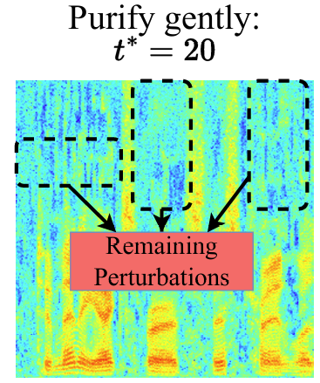
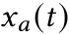
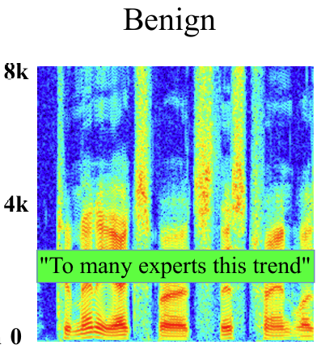
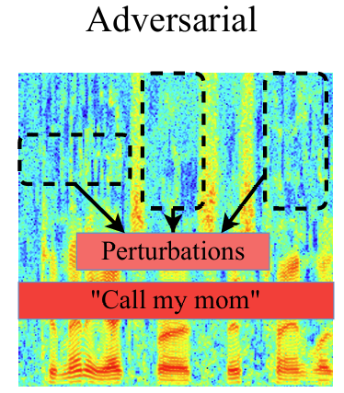
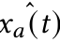
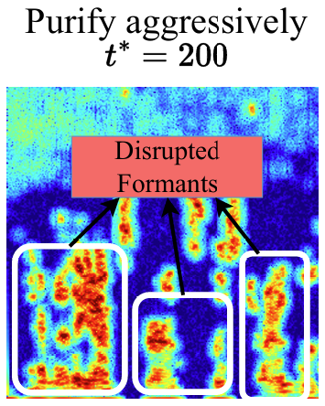
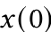
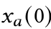
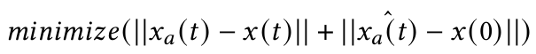
How to determine the optimal purify step?
Forward 20 steps
Backward 20 steps
C&W attack
Forward 200 steps
Backward 200 steps
Add noise to remove perturbation
Recover similar to the benign

Slide 10
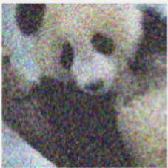
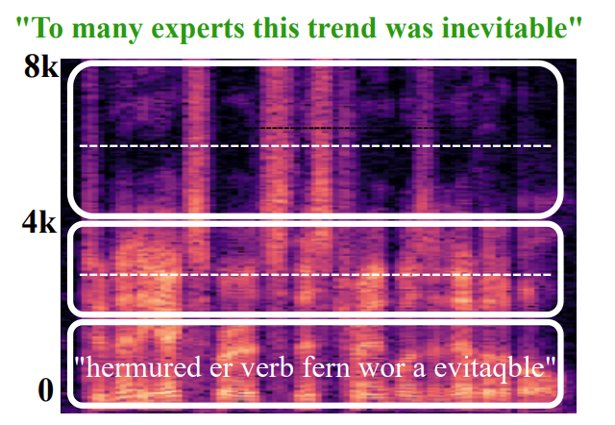
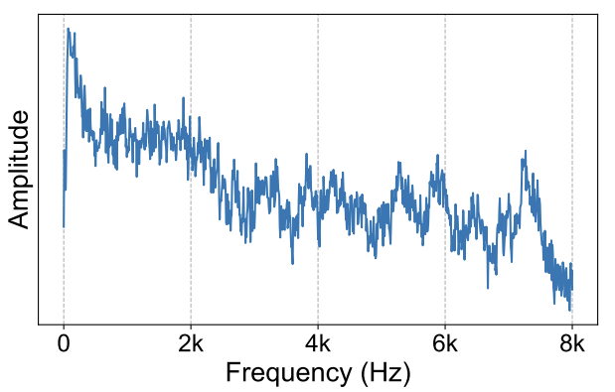
Image VS audio
Image classifier:
Single input and single output
Treats every pixel in the image equally
Perturbation is evenly distributed
Speech recognition:
Sequential model
focus more on the low-frequency formants
Perturbation is added on waveform, not even distributed on Spec
Different frequency components contribute differently to the transcription
Perturbation distribution

Slide 11
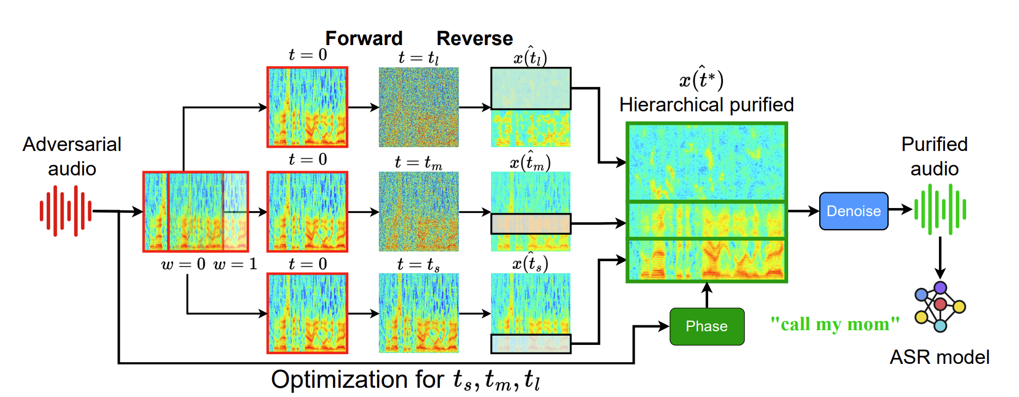
Our design: Hierarchical Diffusion Models

Slide 12
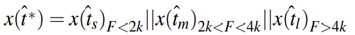
Our design: Optimization Goal
Does not reflect speech recognition goal: Get the correct Transcription
Assure the transcription is recovered; Assure the target is not achieved.
Instead of optimize single t, optimize the combinations.

Slide 13
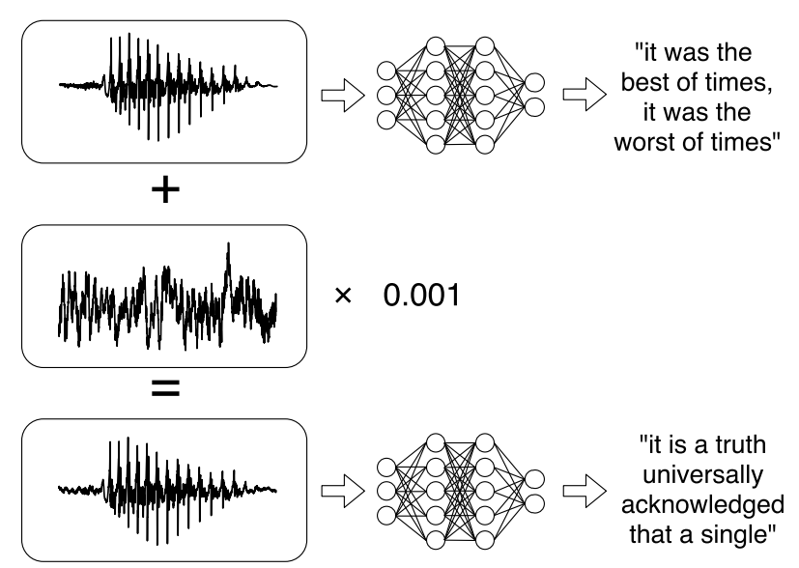
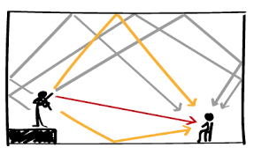
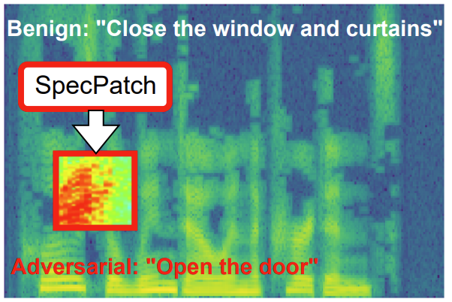

Experiment Setup
Reproduce 3 Speech Recognition Attacks
C&W Attack
SPW 2018 [3]
QIN-I Attack
PMLR 2019[4]
SpecPatch Attack
CCS 2022 [5]
ASR: DeepSpeech
ASR: Lingvo
ASR: DeepSpeech
[3] SPW Nicholas Carlini and David Wagner. 2018. Audio adversarial examples: Targeted attacks on speech-to-text. In 2018 IEEE Security and Privacy Workshops (SPW). IEEE, 1–7
[4] PMLR Yao Qin, Nicholas Carlini, Garrison Cottrell, Ian Goodfellow, and Colin Raffel. 2019. Imperceptible, robust, and targeted adversarial examples for automatic speech recognition. [5] CCS Hanqing Guo, Yuanda Wang, Nikolay Ivanov, Li Xiao, and Qiben Yan. 2022. SpecPatch: Human-in-the-Loop Adversarial Audio Spectrogram Patch Attack

Slide 14
Experiment Setup
Defenses
WaveGuard [USENIX SECURITY 2021]:
- Down-Up 2k: Make a downsampling and upsampling to 2kHz to defend the AE.
- LPC 10: Use Linear Predictive Coding with 10th oreder filter to defend the AE.
- Quant 8: Quantilize the audio samples in 8 bits and then reconstruct back to defend the AE.
Denoise PLoS computational biology:
- ANR: Use adaptive noise reduction to defend the AE.
- SNR: Use stationary noise reduction to defend the AE.
Diffusion [ICLR 2023]:
- DiffSpec: Use Mel-spectrogram based diffusion model to purify AE.
- DiffWave: Use waveform based diffusion model to purify AE.

Slide 15
Experiment Setup
Metrics
CER - Character Error Rate:
Check if purified audio have the same transcription as original. The lower, the better purification performance.
WER – Word Error Rate:
Check if purified audio have the same transcription as original. The lower, the better purification performance.
PSR - Purification Success Rate:
The rate at which purification is successful (When CER is lower than a threshold 0.2)
Typically, an effective model has a CER between 0.05 and 0.2 (e.g., OpenAI’s Whisper)

Slide 16
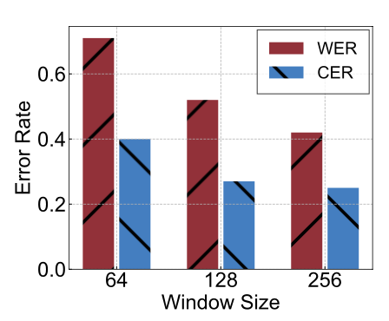
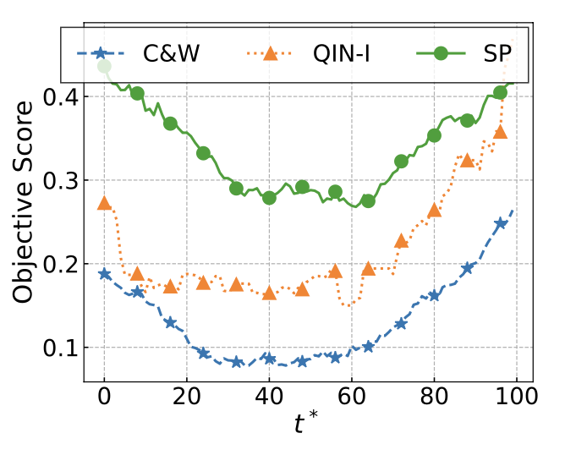
Result
Model Selection:
Guided diffusion from OpenAI
64 ×64, 128 ×128, 256 ×256
Global Purification Step
Searching start point for hierarchy optimal selection

Slide 17
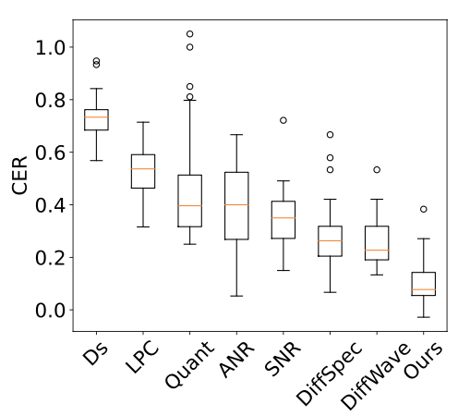
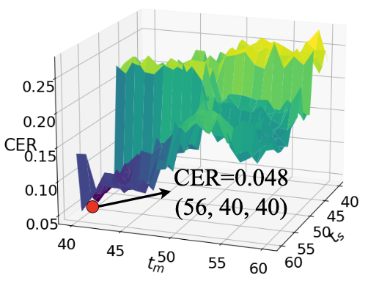
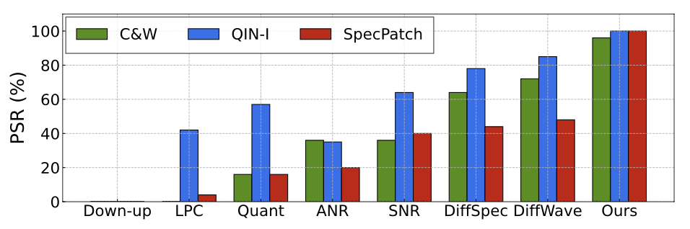
Result
Brutal force find the hierarchical optimal ts, tm, tl.
Achieve the best purification performance

Slide 18
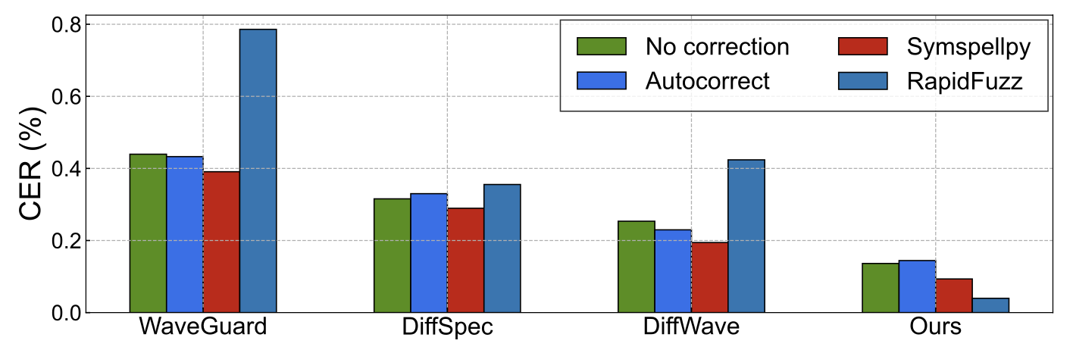
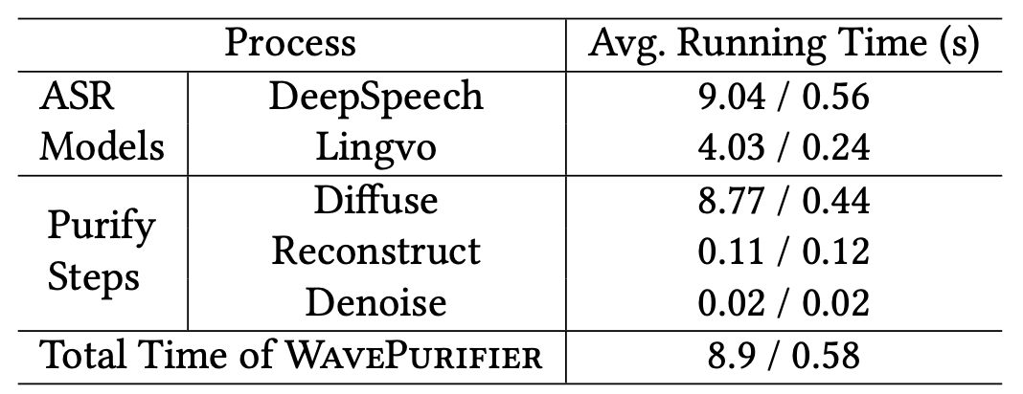
Discussion
Adaptive Attacker?
Out-of-memory;
According to DiffPure, Diffusion-based approach is robust to image adversary.
Running time
Desktop VS Server
Post Auto-correction

Slide 19

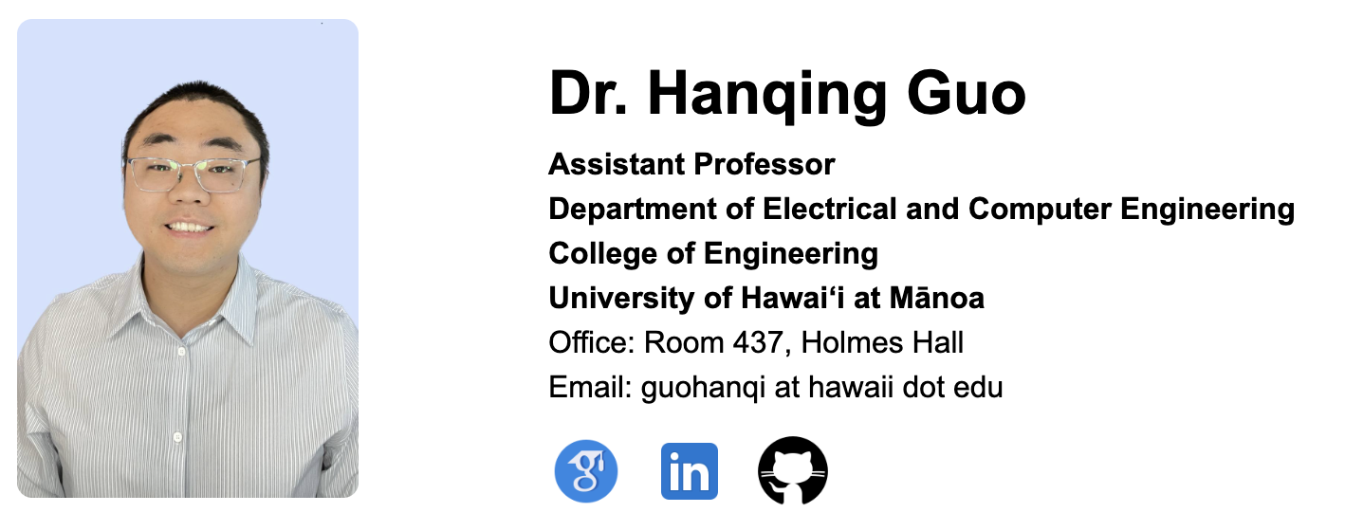

Thank you!
https://wavepurifier.github.io/
Code; Demo; PDF, slides
https://hanqingguo.github.io/ About me.
Team; Opening; Visiting;

